Slide 1
Book1
File created on: 04-07-2022 15:24:50

Slide 2


Slide 3
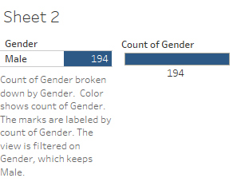

Slide 4
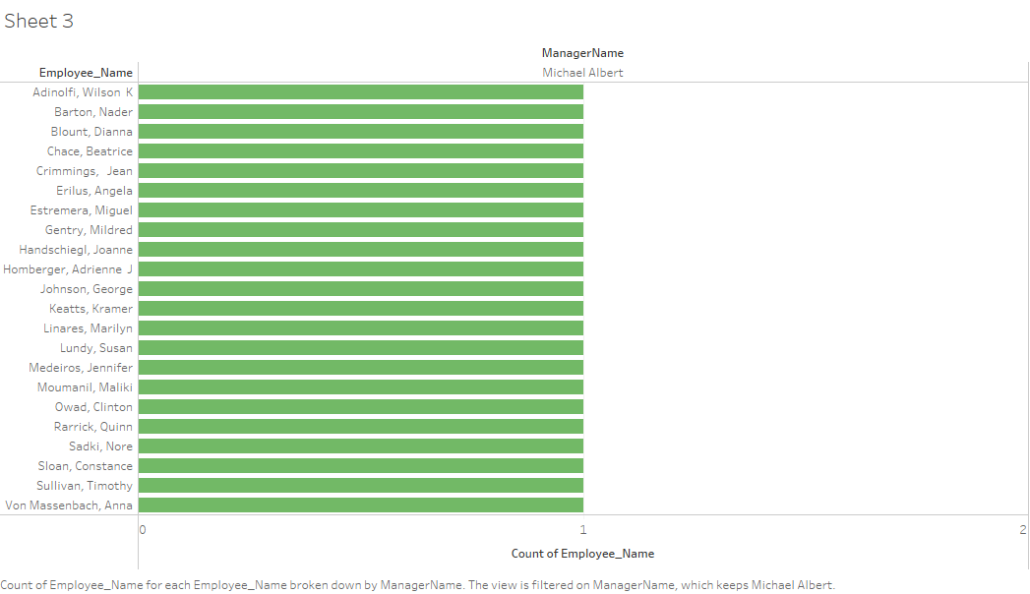

Slide 5


Slide 6


Slide 7
